Slide 1
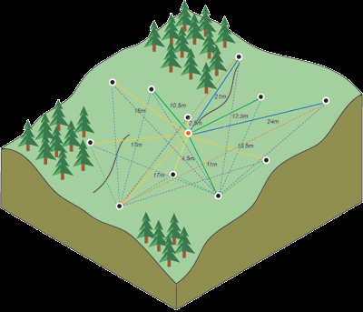
Introducing CCSIM: a Module for…
Comparing Common Spatial Interpolation Methods
Jonathan Schierbaum
GEOG 582 GIS Programming with Python

Slide 2
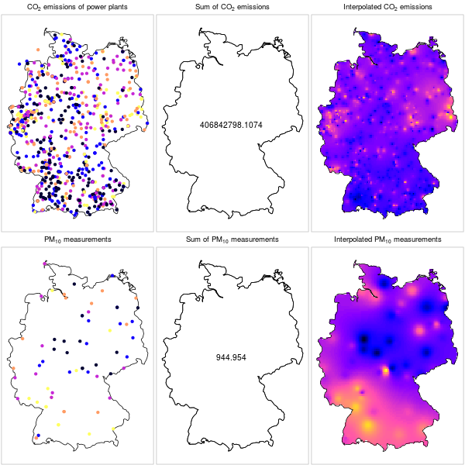
What is Interpolation?
We can’t sample EVERY point in space…
But can we use mathematical models to provide us with an educated guess of what the result might look like if we could?
CCSIM: Comparing Common Spatial Interpolation Methods

Slide 3


Who is CCSIM Trying to Serve and How?
Advanced Users
Basic Users
What’s the best model framework to represent these data in a lower dimensional space or in a less computationally intensive way?
What happens to an interpolated surface when I change this parameter value?
CCSIM: Comparing Common Spatial Interpolation Methods

Slide 4
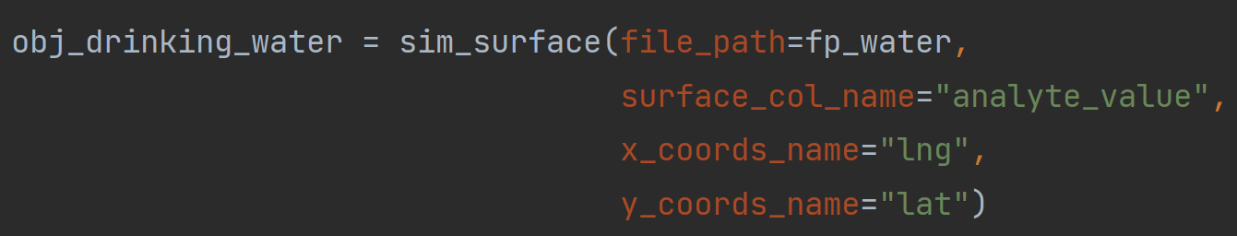
Core Components of CCSIM
Class: sim_surface
Detects, reads and stores input data from a wide variety of filetypes.
Stores and organizes model objects, surface values, and performance metrics for each different surface.
Initializes stored variables needed for the modeling process and checks dimension of input data for errors.
CCSIM: Comparing Common Spatial Interpolation Methods

Slide 5
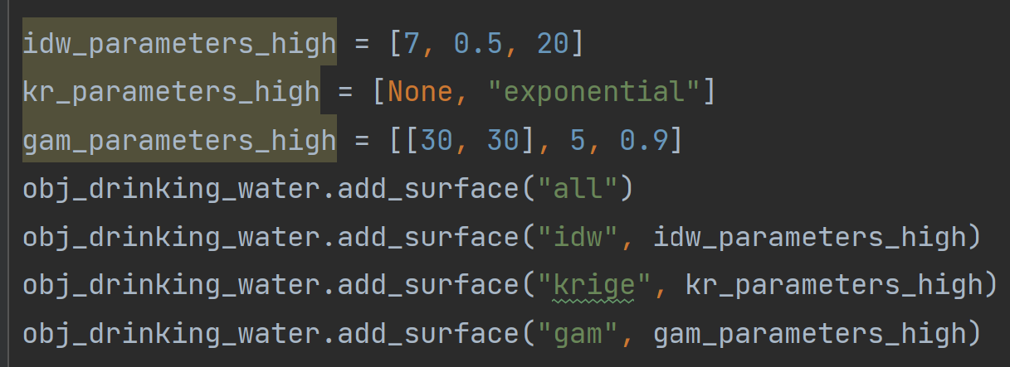
Core Components of CCSIM
Method: add_surface
Adds interpolated surfaces from one or all three of the interpolation methods: Inverse-distance weighting, kriging, and GAM/splines.
Advanced users are able to specify model parameters specific to each model type. If no parameters input, conservative defaults are used.
On initialization, a full raster is interpolated from a grid of points throughout the study area.
CCSIM: Comparing Common Spatial Interpolation Methods

Slide 6
Core Components of CCSIM
A Quick Word on The Spatial Interpolation Methods Used
Inverse-Distance Weighting | Kriging | GAM/Splines
Low complexity Least computationally intensive Estimates are weighted averages of neighboring points Easy parameter values # of neighbors to consider Power term | Medium complexity Always computationally intensive Estimates take into account the overall spatial arrangement of all points. Explainable parameter values Variogram type Nugget, sill, range | High complexity computationally adaptive Estimates consider the overall spatial arrangement of all points, but exchange covariance function for piecewise polynomials tied together at observation points Obscure parameter values Number of basis functions Order of basis functions Smoothing penalty term
CCSIM: Comparing Common Spatial Interpolation Methods

Slide 7
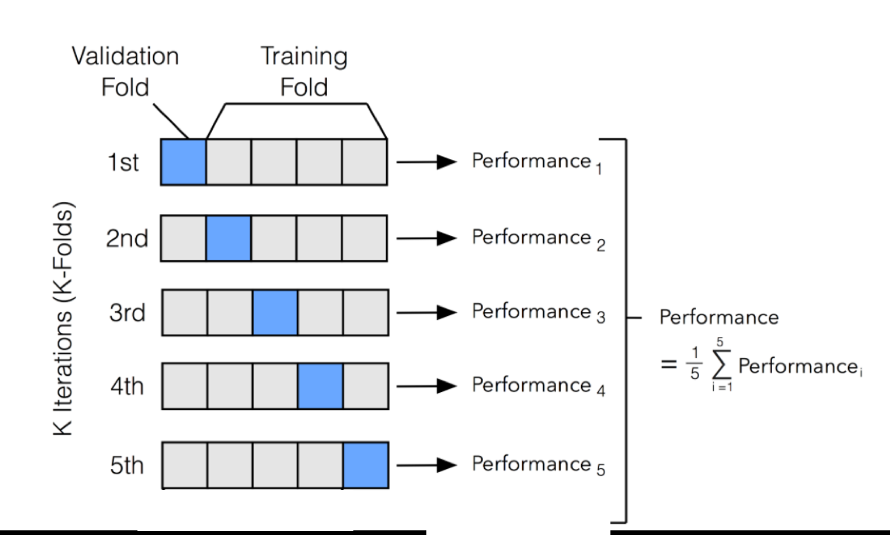
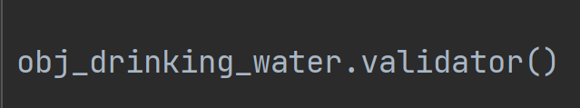
Core Components of CCSIM
Method: validator
Performs leave-one-out cross-validation on the model underlying each surface within the sim_surface() object.
Compares the predictive results against the true withheld values, arriving at a set of accuracy metrics for each surface. Those metrics are mean absolute error, relative mean absolute error, max error, and time to compute.
Leave-one-out cross-validation when n = 5

Slide 8
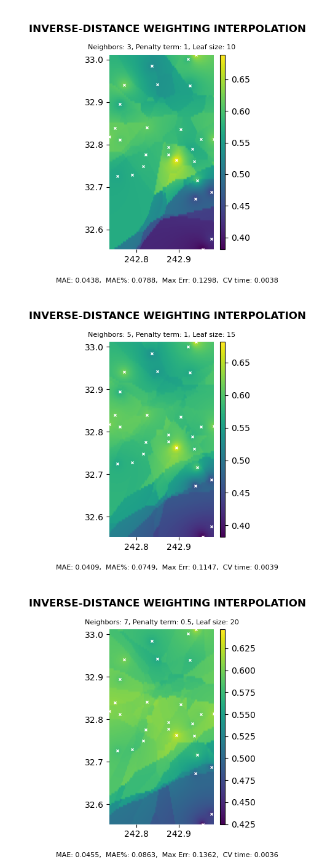
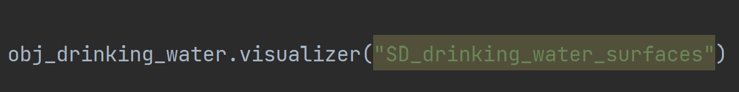
Core Components of CCSIM
Method: visualizer
The primary way users obtain results from the module.
Plots each interpolated surface with its corresponding color bar, an input parameter statement, and an accuracy statement based on its cross-validation results.
Produces presentation ready graphics for 1 to 9 surfaces simultaneously for easy comparison between competing models.
Saves graphic in output folder with desired filename (or default).

Slide 9
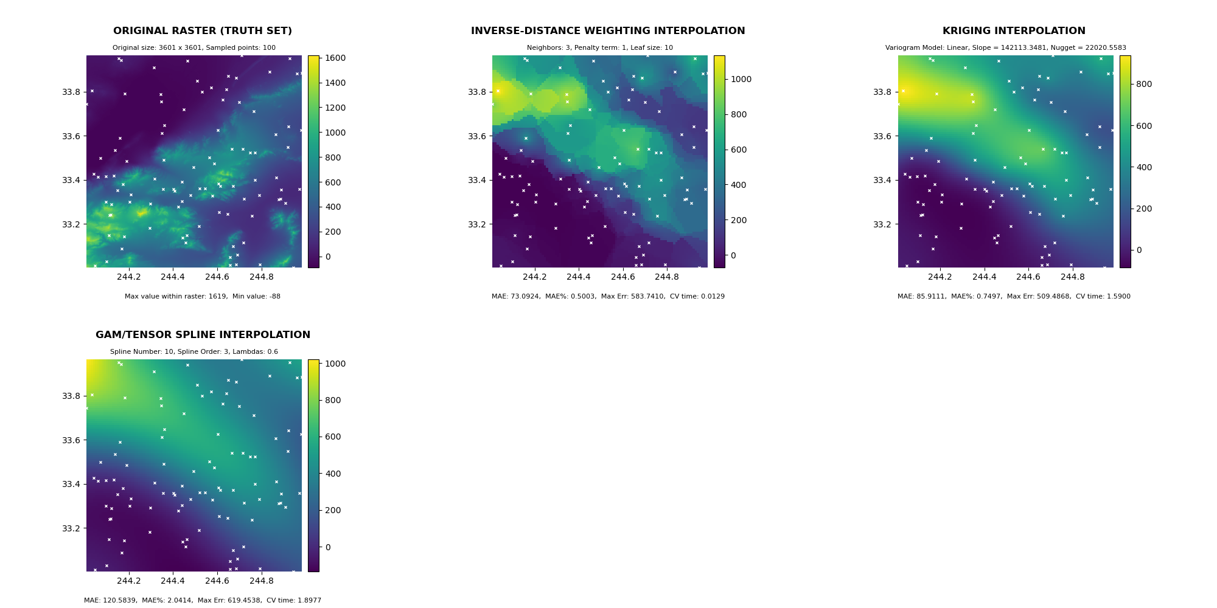
Enhanced Raster Functionality of CCSIM
Feed CCSIM a raster and…
sim_surface | sim_surface.validator() | Sim_surface.visualizer()
Recognizes the data as a “truth” set. On initialization, adds an unaltered copy of the input raster to the model list. Samples a user defined number of points randomly from the image from which to build surfaces with sim_surface.add_surface(). Records information about the original raster image for custom parameter statement. | For the slot containing the truth image, validator records the maximum and minimum values of the raster to use as a custom performance statement. | Reserves the first plot in the visualization for the unaltered truth image, along with its custom parameter and performance statement.

Slide 10
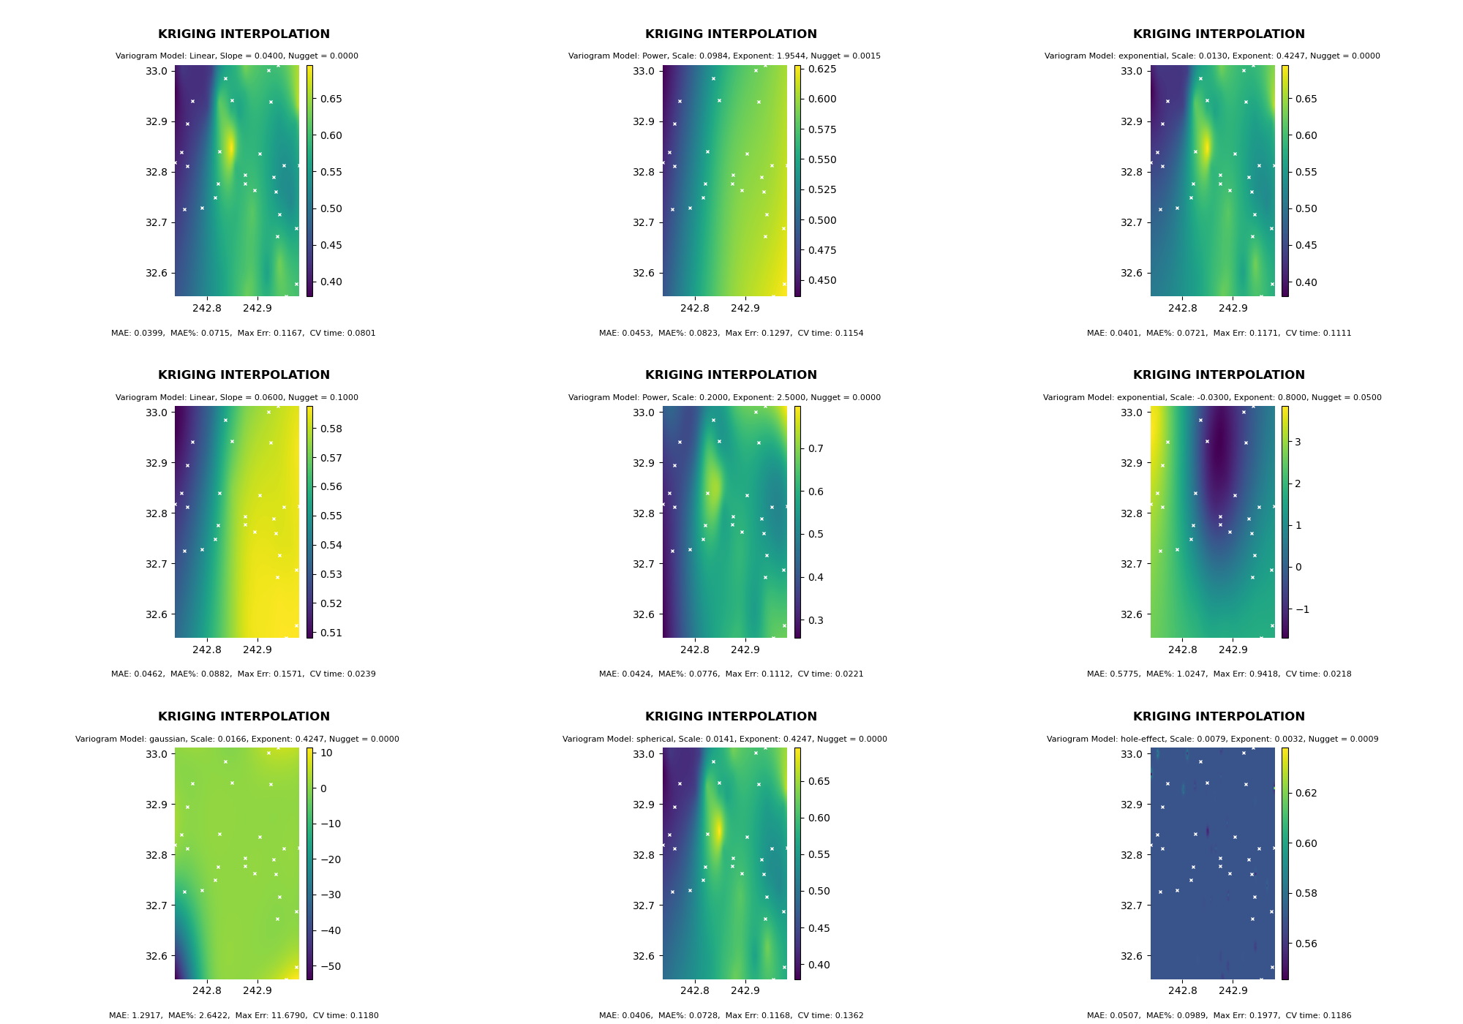
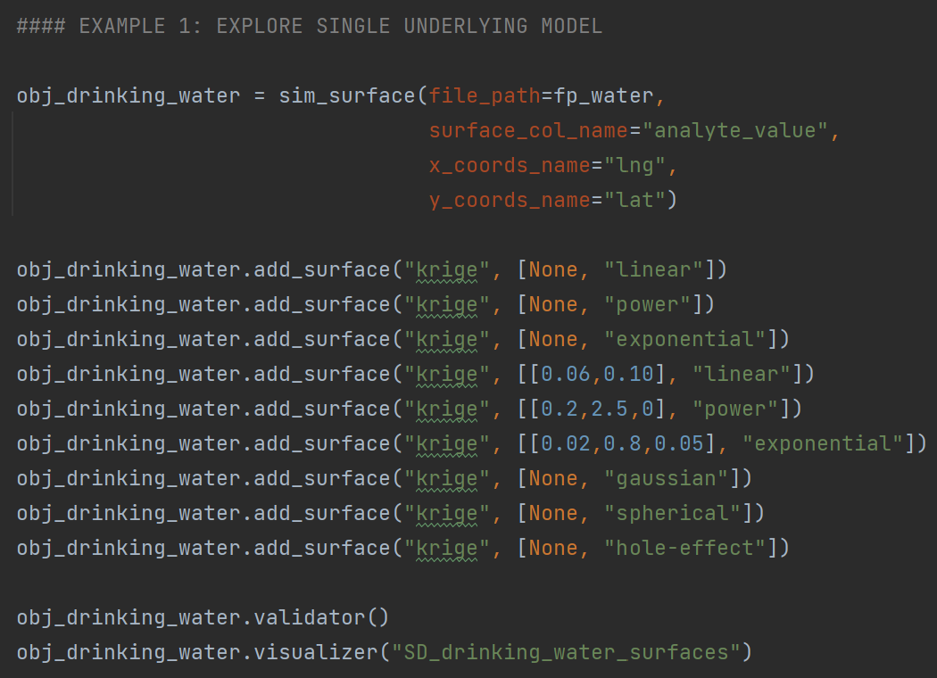
CCSIM Usage
Examples
Exploring
The Parameter
Space of a Single
Model

Slide 11
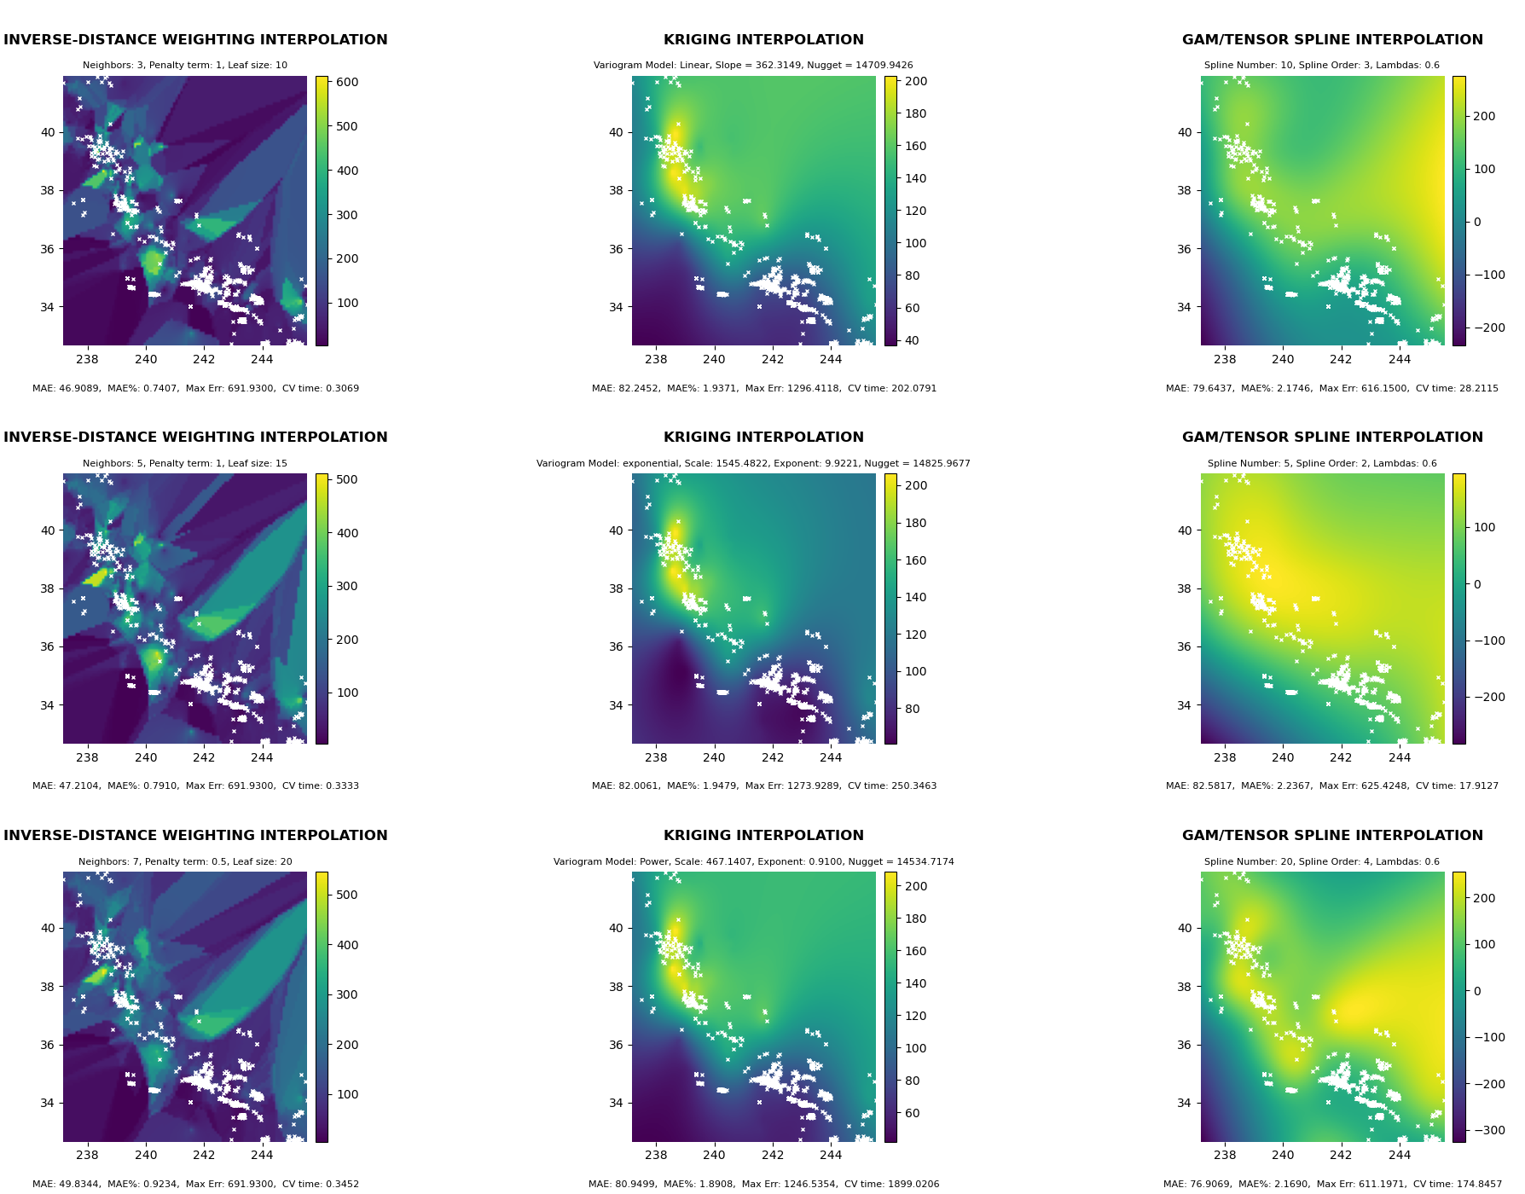
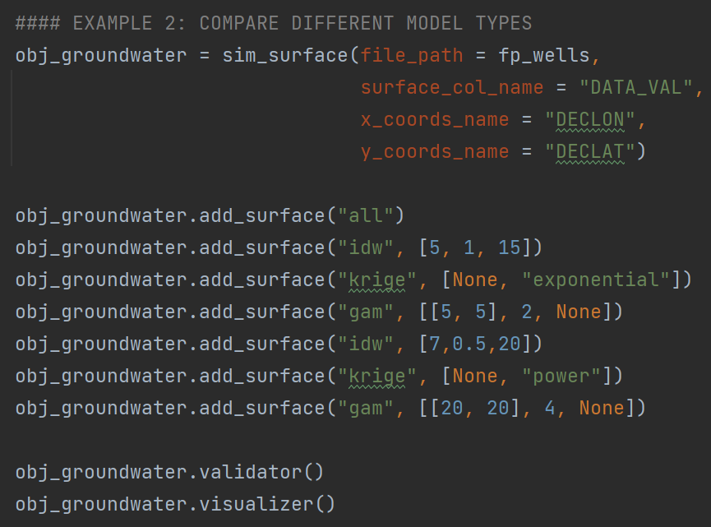
CCSIM Usage
Examples
Comparing
Multiple Models
Simultaneously

Slide 12
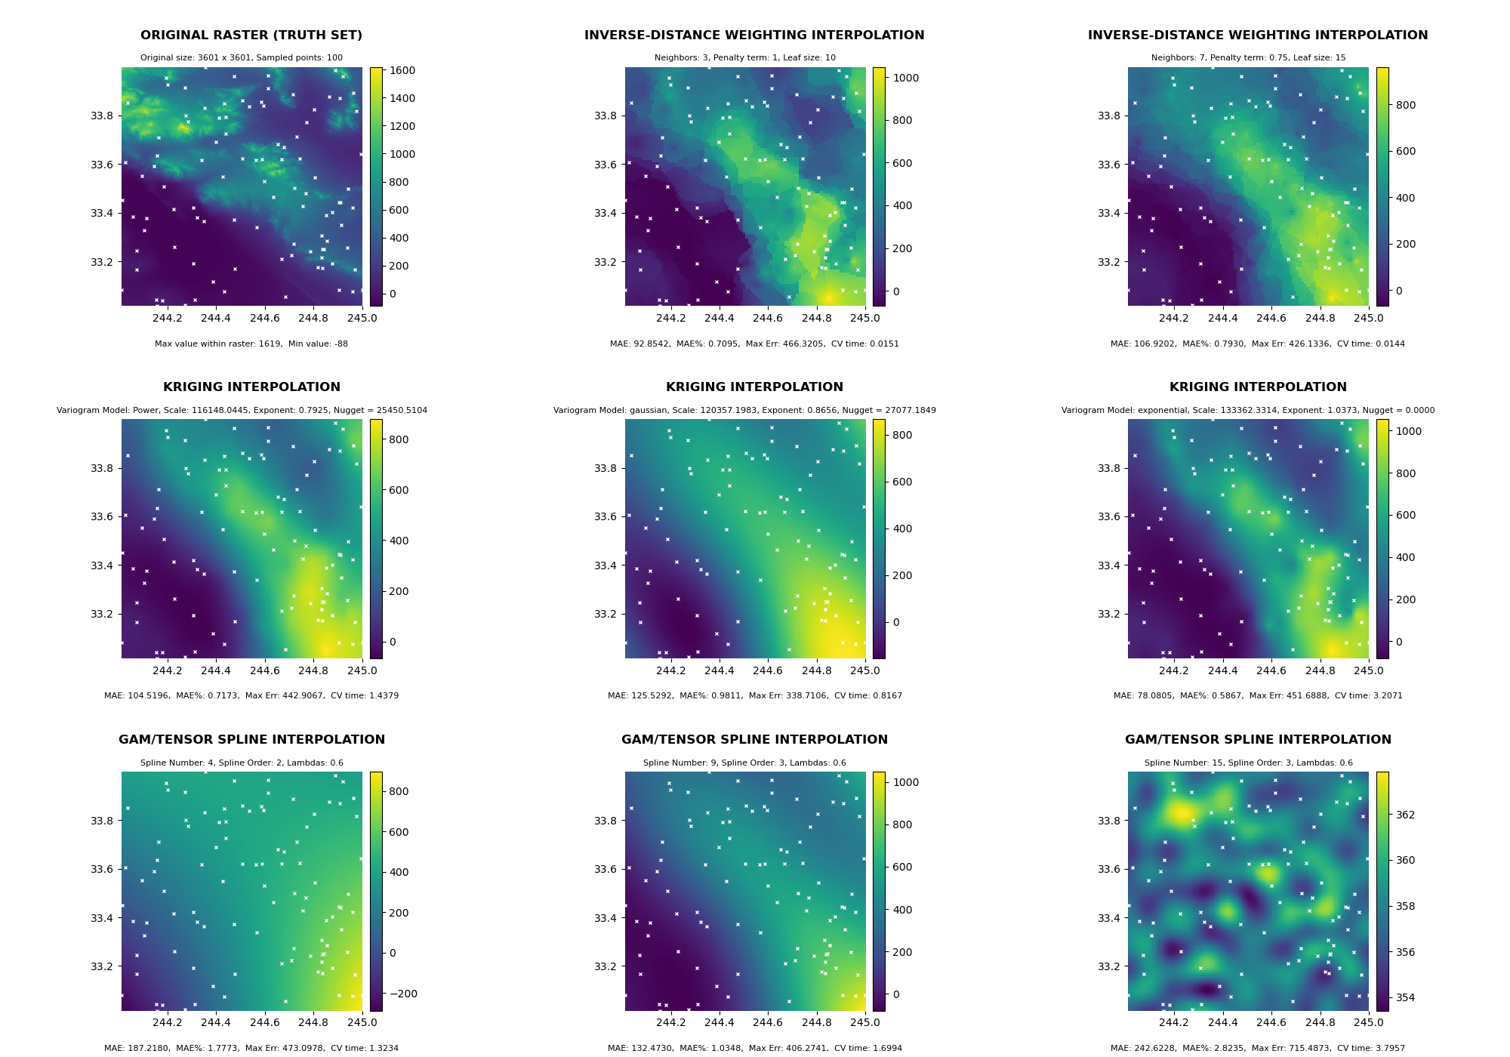
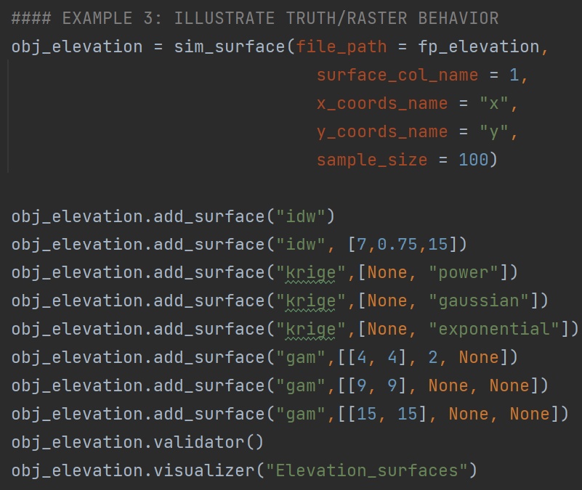
CCSIM Usage
Examples
“Truth” Raster
Behavior

Slide 13
CCSIM Stands on the Shoulders of Giants
External Module | Functionality Summary
Pandas | Diverse filetype read support for tabular data formats
Geopandas | Diverse filetype read support for vector spatial objects
RasterIO | Diverse filetype read support for raster spatial objects
RasterIO.Window | Needed to sample points from rasters
Numpy | Data structure and handling
pyGAM | Model engine for GAM interpolation
PyKrige | Model engine for Krige interpolation
SciPy | Nearest Neighbor Algorithm for IDW interpolation
Sci-kit learn.model_selection | Leave-one-out algorithm for cross-validation
Sci-kit learn.metrics | Mean absolute error, max error calculations for cross-validation
Matplotlib | Graphics engine to produce visualizations
Mpl_toolkits | Adds functionality and customization to plot axes
*Also: os, random, and time

Slide 14
You Haven’t Heard The Last of CCSIM
Near-Term Improvements | Medium-Term | Long-Term
The capability to overlay semi-transparent interpolated surface rasters on top of satellite imagery base plots Utilize multiprocessing to assist the cross-validation of functionality with larger datasets | Support for additional data types beyond continuous data Additional interpolation methods | Expand the framework of the CCSIM module to support multivariate prediction methods
But have I heard the last of you?
(Questions?)

